Slide 1
JAGS
Lecture 1

Slide 2



Gibbs Sampling
The following algorithm can be used to generate a vector
X from a distribution p(X):
Select X₀
Generate from
This algorithm depends on being able to write down:
for all j.

Slide 3
BUGS machinery
BUGS (Bayesian inference Under Gibbs Sampling) selects how to generate values for the parameters at each step of the algorithm:
  Conjugate prior: Gibbs sampling
  Log concave prior: Derivative Free Adaptive Rejection
  Restricted range prior: Slice sampling
  Unrestricted range: Metropolis sampling
Thankfully BUGS makes the decisions on how to sample.

Slide 4
Implementation
WinBUGS:
  http://www.mrc-bsu.cam.ac.uk/software/bugs/the-bugs-project-winbugs/
JAGS (Just Another Gibbs Sampler):
  http://mcmc-jags.sourceforge.net/
OpenBUGS
  http://www.openbugs.net/w/FrontPage
Both WinBUGS and JAGS can be accessed via R

Slide 5
Pros and Cons of BUGS
Cons
  Syntax takes some time to grasp (but well worth it)
  Models can be slow and in some cases may not converge
  Error messages are often incomprehensible
Pros
  Syntax forces the modeler to consider the sources of variability
  Must explicitly state how variability occurs and an appropriate statistical distribution
  Hierarchical modeling is relatively easy
  Modeling the variance is relatively easy (e.g., over-dispersion in the data, spatial autocorrelation, etc.)
  Evaluating alternative priors is really easy
  Lots of examples and help!

Slide 6
R Packages
r2WinBUGS
rjags
runjags
We will focus on runjags.

Slide 7
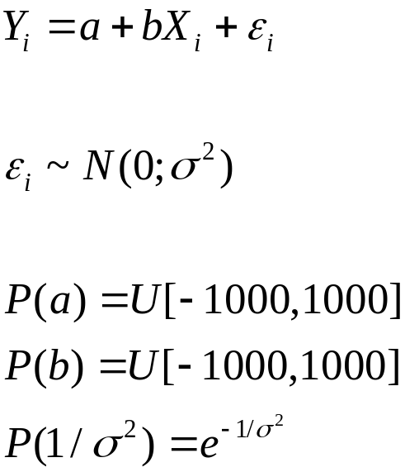
A First Example-I
Regression equation
Error model
Priors

Slide 8
A First Example-II
Math
BUGS
model {
for(i in 1 : N){
Y[i] ~ dnorm(true.y[i], precision)
true.y[i] <- (coef * X[i]) + int
}
coef ~ dunif(-1000,1000)
int ~ dunif(-1000,1000)
sigma <- 1.0/sqrt(precision)
precision ~ dexp(1)
}

Slide 9
A First Example-III
model {
for(i in 1 : N){
Y[i] ~ dnorm(true.y[i], precision)
true.y[i] <- (coef * X[i]) + int
}
coef ~ dunif(-1000,1000)
int ~ dunif(-1000,1000)
precision ~ dexp(1)
sigma <- 1.0/sqrt(precision)
}
Error model
Expected value
Uniform priors
Exponential priors

Slide 10
Running JAGS
data <- list(X=X, Y=Y, N=length(X))
inits1 <- list(coef=1, int=1, precision=1,
.RNG.name="base::Super-Duper", .RNG.seed=1)
inits2 <- list(coef=0.1, int=10, precision=1,
.RNG.name="base::Wichmann-Hill", .RNG.seed=21)
results <- run.jags(model=model, monitor=c("coef", "int", "precision","sigma"),
data=data, n.chains=5, method="rjags", inits=inits,plots=T,monitor.deviance=T)
print(results)
plot(results,type="trace",,layout=c(2,2))

Slide 11
Runjags-I
Runjags(model, monitor, data, n.chains,inits)
model: a string (or file name) which starts with model { and ends with }
monitor: a [character] vector of outputs to monitor. You can also monitor DIC.
data: list of data elements.
n.chains: number of chains.
inits: either a list of initial values for each parameter [by chain] or a function.
.RNG.seed: random number seed for the current chain
.RNG.name: random number generator for the current chain.

Slide 12
Runjags-II
Other useful inputs to runjags:
silent.jags: reduce the amount of material dumped.
plots: automatically create trace and density plots.
burnin: specify which cycles to use.
samples: specify how many samples to generate.
thin: specify thinning ratio.
method: this option can be used to run jags in parallel (including using the Snow package).
autorun.jags: can be used to conduct simulations involving jags (with automatic stopping criteria).
extend.jags: can be used to conduct additional cycles for an existing model.

Slide 13
More about runjags
You can avoid passing data and initial values using #data# and #inits# in the model [not something I do]

Slide 14
Notation and syntax
The key step in developing a JAGS model is to identify the stochastic and deterministic nodes.
Stochastic node: something that is directly associated with a probability distribution:
  Likelihoods: y[i] ~ dnorm(mean,precision)
  Priors: mean ~ dgamma(0.01,0.01)
Deterministic node: something that is a function of something else (which may be a stochastic node)
  Mi[i] <- alpha + beta*x[i]

Slide 15
What JAGS can do
Loops
Many, many distributions (be careful when interpreting the parameters of a distribution).
Scalars, vectors, and matrices.
NAs
Truncation, censoring and rounding.
Functions, including “exp”, “log” and even inverse.
Set seeds (and random number generators)
Compute DIC and Gelman-Rubin statistic
Pass material to CODA

Slide 16
What JAGS can’t do
If statements (you can get away with using NAs in data files – at least sometimes).
No debugging tools but:
  Look at failedjags$model, failedjags$data, failedjags$inits
Extract vectors from matrices.

Slide 17
Hints
Liberally use { and }!
The following code doesn’t work:
  J <- x[i]
  Y[i] ~dnorm(alpha + beta[J],tau)
and the following does
  Y[i] ~dnorm(alpha + beta[x[i]],tau)

Slide 18

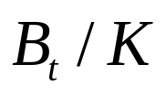
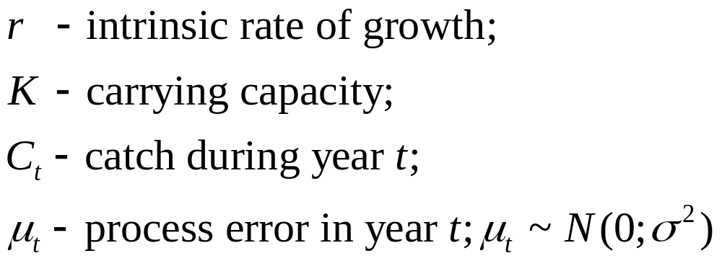
Example: The Schaefer Model-I
Define to be and assume that the process is log-normally distributed, i.e.:
where:
(based on Meyer and Millar, 1999)

Slide 19
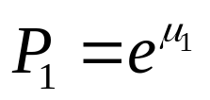

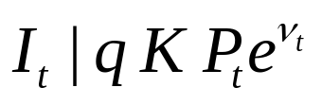
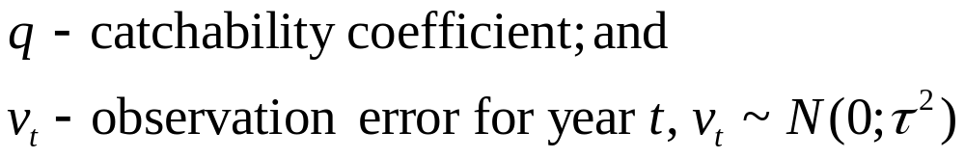
Example: The Schaefer Model-II
We also need initial conditions:
Now assume that we have an index of relative abundance, , which is also log-normally distributed, i.e.:
where:

Slide 20
State-space models
Incorporates randomness in the underlying process (process noise) and error in the observations (measurement error).
Bayesian modelling for state-space models provides improvements over previous approaches (e.g., Kalman Filter which assumes Gaussian process noise and measurement error).
Often need to structure the two sources of error (use informative priors on one of them), or estimate their ratio.
Some good papers:
  Buckland et al. 2007 (Statistical Science 22:44)
  Newman et al. 2009 (Biometrics 65:572)

Slide 21
States and Observables
A state-space model makes clear which are:
  the data (the Is),
  the parameters (K, q, r, σ, and τ); and
  unobserved states (P_{t}:t=1,2…,n)

Slide 22
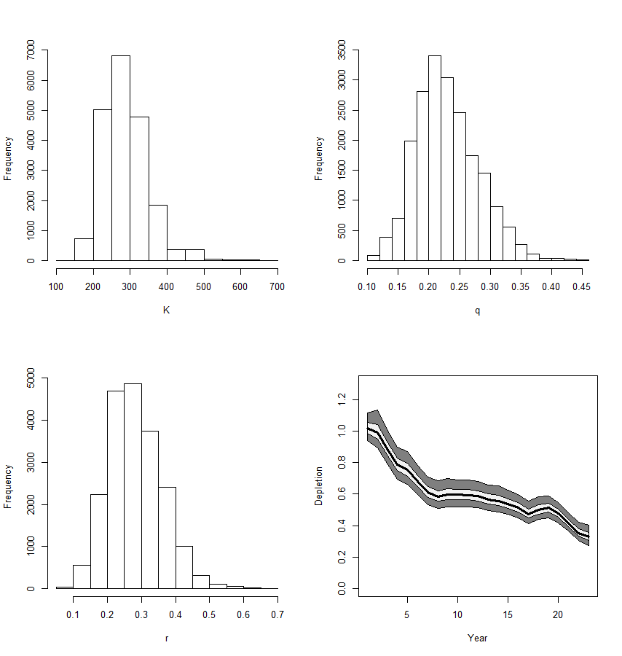
Posteriors for the
parameters and
for the trajectory
of biomass /K.

Slide 23
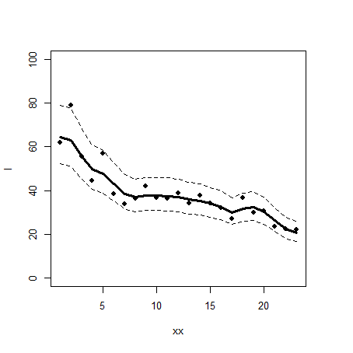
The catch-rate data with the posterior predictive
distribution superimposed

Slide 24
More Examples
There are many examples (see the JAGS website)

Slide 25
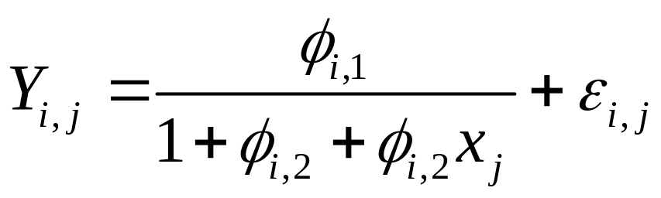
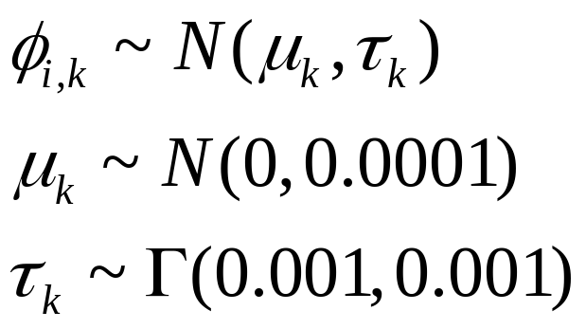
Example
(a non-linear random effects model)
The observation model is of the form:
There are priors and hyper-priors:

Slide 26
Example
(a non-linear random effects model)
model {
for (i in 1:K) {
for (j in 1:n) {
Y[i, j] ~ dnorm(mean[i, j], tauC)
mean[i, j] <- phi[i, 1] / (1 + phi[i, 2] * exp(phi[i, 3] * x[j]))
}
phi[i, 1] <- exp(theta[i, 1])
phi[i, 2] <- exp(theta[i, 2]) - 1
phi[i, 3] <- -exp(theta[i, 3])
for (k in 1:3) {
theta[i, k] ~ dnorm(mu[k], tau[k])
}
}
tauC ~ dgamma(1.0E-3, 1.0E-3)
sigmaC <- 1 / sqrt(tauC)
for (k in 1:3) {
mu[k] ~ dnorm(0, 1.0E-4)
tau[k] ~ dgamma(1.0E-3, 1.0E-3)
}
}
Model and likelihood
Priors
Hyper-priors

Slide 27
Linear model with random and fixed effects-I
model {
for(p in 1:N) {
Y[p] ~ dnorm(mu[p], tau[p]);
mu[p] <- alpha[school[p],1] + alpha[school[p],2]*LRT[p]
+ alpha[school[p],3]*VR[p,1] + beta[1]*LRT2[p]
+ beta[2]*VR[p,2] + beta[3]*Gender[p]
+ beta[4]*School.gender[p,1] + beta[5]*School.gender[p,2]
+ beta[6]*School.denom[p,1] + beta[7]*School.denom[p,2]
+ beta[8]*School.denom[p,3];
log(tau[p]) <- theta + phi*LRT[p];
sigma2[p] <- 1/tau[p];
LRT2[p] <- LRT[p]^2;
}
}
The model and the
likelihood

Slide 28
Linear model with random and fixed effects-II
# Priors for fixed effects:
for (k in 1:8) { beta[k] ~ dnorm(0.0, 0.0001); }
theta ~ dnorm(0.0, 0.0001); phi ~ dnorm(0.0, 0.0001);
# Priors for random coefficients:
for (j in 1:M) {
alpha[j,] ~ dmnorm(gamma[], T[,]);
}
# Hyper-priors:
gamma[] ~ dmnorm(mn[], prec[,]);
T[,] ~ dwish(R[,],3);
Priors and hyper-priors

Slide 29
Readings and References
Jags Manual:
  http://people.math.aau.dk/~kkb/Undervisning/Bayes14/sorenh/docs/jags_user_manual.pdf
Matthew Denwood’s article on JAGS:
  http://cran.r-project.org/web/packages/runjags/vignettes/runjags.pdf

